Slide 1
Fall detection/prediction
電機四 B05901038 陳元芃
電機四 B05901164 曹峻豪
電機四 B05901071 孫鍾恩

Slide 2
Motivation
Falls in the elderly have always been a serious medical and social problem. To detect and predict falls, a hidden Markov model (HMM)-based method using tri-axial accelerations of human body is proposed

Slide 3
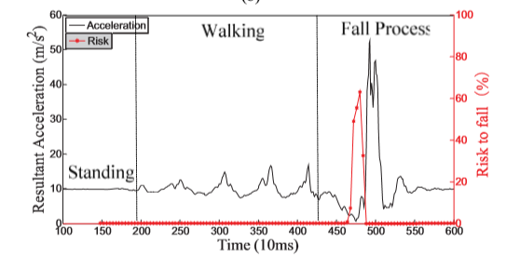
How to realize ?
We will train three hmm models for standing, walking and falling. Each model has three states and eight observations. The window size (observation sequence length) is 5sec with stride equals to 0.5sec.
Red line would be the desired output probability of the model of falling predict that we intend to achieve

Slide 4
Training
Collect the dataset of 50~100 sample for each model
Using sklearn MultinomialHMM to realize the discrete version of hmm

Slide 5
Inference
We will run Viterbi algorithm to compute the likelihood of each model
All the inference will be done on STM32, need not any external operation

Slide 6
Expected Results
A wearable motion detection device using tri-axial accelerometer in STM32 is designed and realized, which can detect and predict falls (also for walking and standing).

Slide 7
Preliminary Lab/Try
Use Rpi as the socket server to connect to the STM32 and read the acceleration value
Read paper and design the hmm structure that we will train soon

Slide 8
References
https://ieeexplore.ieee.org/stamp/stamp.jsp?tp=&arnumber=6450028

